Slide 1
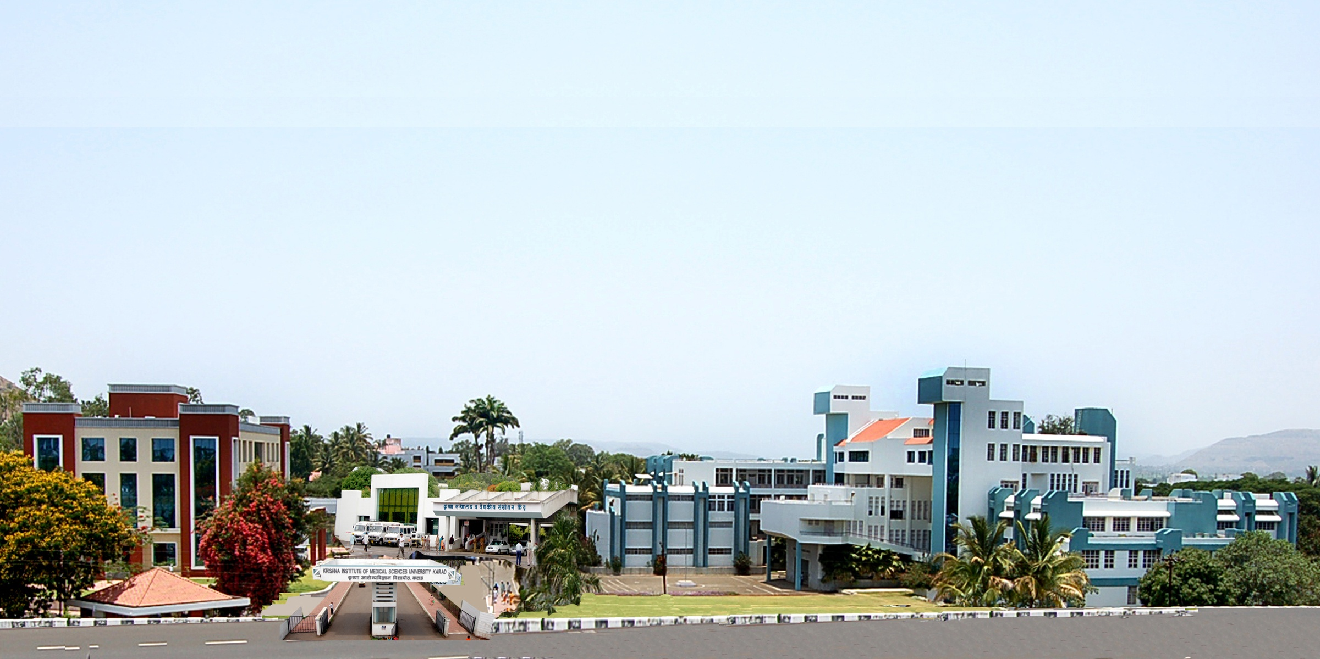
KRISHNA INSTITUTE OF MEDICAL SCIENCES
DEEMED TO BE UNIVERSITY, KARAD
LEAD REFERRAL LABORATORY

Slide 2
KRISHNA INSTITUTE OF MEDICAL SCIENCES UNIVERSITY, KARAD
LEAD REFERRAL LABORATORY
Lead referral laboratory (1st of it’s kind in
Maharashtra) established on 9th Feb 2012 at
Department of Biochemistry, KIMSDU, Karad,
with collaboration of National Referral Centre
for Lead Projects of India, Bangalore and Indian
Society of Lead Awareness and Research
Recognized by the WHO as a Rural Lead Referral
Centre

Slide 3
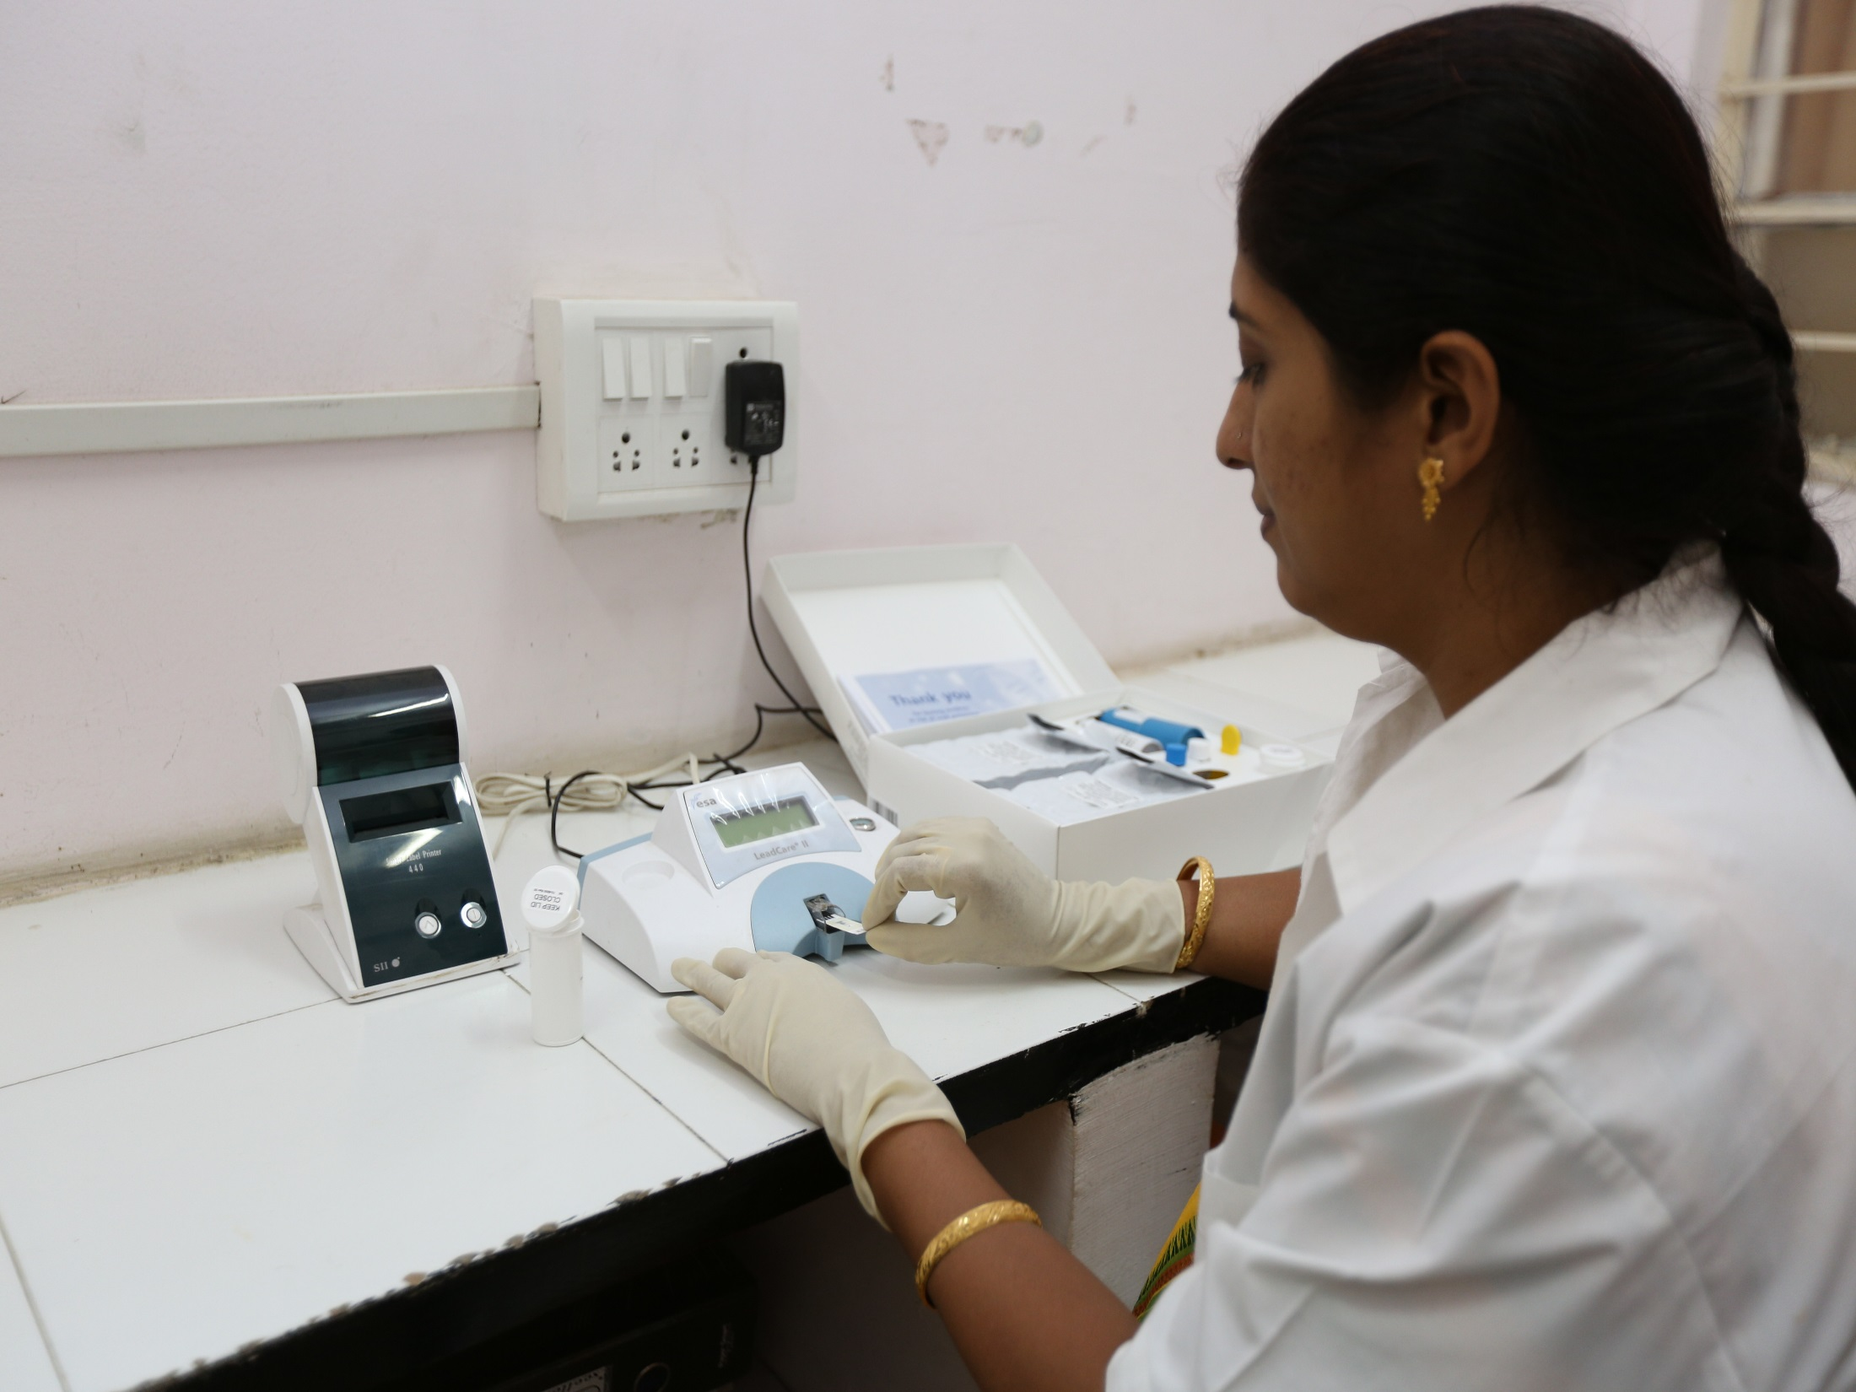

Slide 4
Lead Referral Laboratory Committee (Constituted as per the norms of the NRCLPI, Bangalore)
No. | Name of the Members | Designation
1. | Hon’ble Dr. (Mrs), Neelam Mishra Vice Chancellore, KIMSDU, Karad | Chairman
2 | Dr. V.Y. Kshirsagar Professor & Head, Dept. of Paediatric | Member
3 | Dr. R. P. Patange Professor & Head, Dept. of Obs /Gyn | Member
4 | Dr. V. C. Patil Professor & Head, Dept. of Medicine | Member
5. | Dr. A. V. Sontakke, Professor & Head, Dept. of Biochemistry | Member
6 | Professor N. Shashidhar, NRCLP, St John’s Med. College, Bangalore | Member
7 | Mr. A. A. Khamkar, Maharashtra Pollution Control Board, Satara | Member
8 | Dr. Arun J. Patil, Professor in Biochemistry | Member Secretary

Slide 5
Details of Lead Referral Laboratory Staffs
Name | Designation | Qualifications | Experience (Yrs)
Dr. Arun J. Patil | Professor | M.Sc. (Med) Ph.D (Med) | 27
Dr. (Mrs). Jyotsna A. Patil | Associate Professor | M.Sc. Ph.D (Med) | 27
Dr. (Mrs). Mandakini Kshirsagar | Assistant Professor | M. Sc. (Med) | 10
Dr. Ganesh Ghanwat | Tutor | M. Sc. (Med) | 9
Mrs. Asmita Joshi | Technician | B.Sc. DMLT | 25
Mr. Jaywant Thorat | Technician | M. Sc (Med) B.Sc. DMLT | 24
Mrs. Madhura Dhaigude | Technician | M. Sc (Med) B.Sc. DMLT | 12

Slide 6
Blood lead level is measured by Lead Care II Blood
lead Analyzer (ESA, Magellan Biosciences, USA).
Subjects | Number of Samples
Battery Manufacture Workers | 907
Silver Jewellery Workers | 294
Spray Painters | 305
School Children | 208
Neurological Disorder Children | 035
Healthy Adult Female | 100
Healthy Adult Male | 187
Total Blood Lead Samples | 2036

Slide 7
Research Project Completed & Published Papers
No. | Authors Name | Title | Journal Name
1 | Shilpa A. Pratinidhi, Arun J. Patil, Manaskumar Behera, Maya Patil, Dnyaneshwari P. Ghadage, Asha K. Pratinidhi | Effects of blood lead level on biochemical and haematological parameters in children with neurological disease of western Maharashtra, India | J. Basic Clinical Physiology Pharmacology NovNovember 2013, Volume 25, Issue 2, Page 229-233, (PubMed, Scopus)
2 | Mrs. Mandakini Kshirsagar, Dr. Jyotsna Patil, Dr. Arun Patil, Mr. Ganesh Ghanwat, Dr. Ajit Sontakke, Dr. R. K. Ayachit | Biochemical Effects of Lead Exposure and Toxicity on Battery Manufacturing Workers of Western Maharashtra (India): With Respect to Liver and Kidney Function Tests | Al Ameen J. Med Sciences 2015; 8(2):107-114

Slide 8
Research Project Completed & Published Papers
No. | Authors Name | Title | Journal Name
3 | Mr. Ganesh Ghanwat, Dr. Arun Patil, Dr. Jyotsna Patil, Mrs. Mandakini Kshirsagar, Dr. Ajit Sontakke, Dr. R. K. Ayachit | Biochemical Effects of Lead exposure on Oxidative Stress and Antioxidant Status of Battery Manufacturing Workers of Western Maharashtra, India. | Journal of Basic Clinical Physiology and Pharmacology, 2016; 27(2): 141–146. (PubMed, Scopus)
4 | Mr. Ganesh Ghanwat, Dr. Arun Patil, Dr. Jyotsna Patil, Mrs. Mandakini Kshirsagar, Dr. Ajit Sontakke, Dr. R. K. Ayachit. | Effects of Vitamin C Supplementation on Blood Lead Levels, Oxidative Stress and Antioxidant Status of Battery Manufacturing Workers of Western Maharashtra, India. | Journal of Clinical and Diagnostic Research. April 2016, Vol.10, Issue 4, Page BC08-BC-11. (PubMed, Scopus)

Slide 9
Research Project Completed & Published Papers
No. | Authors Name | Title | Journal Name
5 | Mrs. Mandakini Kshirsagar, Dr. Jyotsna Patil, Dr. Arun Patil, Mr. Ganesh Ghanwat, Dr. Ajit Sontakke, Dr. R. K. Ayachit. | Biochemical Effects of Lead on Battery Manufacturing Workers of Western Maharashtra (India): With Respect to Haem Biosynthesis and Haematological Parameters. | J Pharm Chem Biol Sci, December 2015-February 2016; 3(4):477-487. (Scopus)
6 | Shilpa A Pratinidhi, Aparna A Sagare, Arun J Patil. | Heavy Metal Levels in Commonly used Cosmetic Products in Asia. | MIMER Medical Journal, 2018, Vol 2, Issue 2, 31-36.

Slide 10
Research Project Completed & Published Papers
No. | Authors Name | Title | Journal Name
7 | Dr. Jyotsna A. Patil, Mrs. Mandakini S. Kshirsagar, Dr. Arun Patil. | Activated Carbon Fabric Mask Reduces Lead Absorption and Improves the Heme Biosynthesis and Hematological Parameters of Battery Manufacturing Workers. | Ind J Clin Biochem (2019). https://doi.org/10.1007/s12291-019-00868-3. (Scopus, PubMed)
8 | Mandakini Kshirsagar, Jyotsna Patil, Arun Patil. | Increased Blood Lead Level Alters the Heme Biosynthesis and Haematological Parameters of Spray Painters from Western Maharashtra, India. | Toxicol. Environ. Health. Sci. Vol. 11(2), 168-174, 2019. (Scopus)

Slide 11
Research Project Completed & Published Papers
No. | Authors Name | Title | Journal Name
9 | Mandakini S. Kshirsagar, Arun J. Patil, Jyotsna A. Patil. | Impact of Occupational Lead Exposure on Liver and Kidney Function Tests of Silver Jewellery Workers. | Journal of Clinical Diagnostic Research, DOI: 10.7860/JCDR/2019/38084.12442.
10 | Mandakini S. Kshirsagar, Arun J. Patil, Jyotsna A. Patil. | Biochemical Effects of Lead on Heme Biosynthesis and Hematological Parameters of Silver Jewellery Workers of Western Maharashtra, India. | International Journal of Research Pharmaceutical Science (Accepted for Publication).

Slide 12
Research Project Completed & Published Papers
No. | Authors Name | Title | Journal Name
11 | Mrs. Mandakini S. Kshirsagar, Dr. Jyotsna A. Patil, Dr. Arun Patil. | Elevated Blood Lead Levels Induces Oxidative Stress and Alters the Antioxidants Status of Silver Jewellery Workers of Western Maharashtra, India. | International Journal of Research Pharmaceutical Science, 2020, 11(4), 7254-7258.
12 | Mandakini S. Kshirsagar, Arun J. Patil, Jyotsna A. Patil. | Increased Blood Lead Levels Induces Oxidative Stress and Alters the Antioxidants Status of Spray Painters. | J Basic Clin Physiol Pharmacol (Accepted for publication)

Slide 13
Research Project Completed & Published Papers
No. | Authors Name | Title | Journal Name
13 | Mrs. Mandakini S. Kshirsagar, Dr. Arun Patil, Dr. Jyotsna A. Patil. | Elevated Blood Lead Level Alters the Liver and Kidney Function Tests of Spray Painters. | Indian Journal of Forensic Medicine and Toxicology. (Accepted for Publication
14 | Mrs. Mandakini S. Kshirsagar, Dr. (Mrs). Jyotsna A. Patil, Dr. Arun J. Patil. | Effects of Supplementation of Multivitamins and Multiminerals on Blood Lead Level, Oxidative Stress and Antioxidant Parameters of Silver Jewellery Workers from Western Maharashtra, India | Australian Journal of Occupational Therapy (Submitted on 6.3.2020)

Slide 14
Research Project Completed & Published Papers
No. | Authors Name | Title | Journal Name
15 | Mrs. Mandakini S. Kshirsagar, Dr. (Mrs). Jyotsna A. Patil, Dr. Arun J. Patil. | Elevated Blood Lead Level Alters the Heme Biosynthesis and Haematological Parameters of Unorganised Batter Manufacturing Workers from Western Maharashtra, India. | Journal of Environmental Pathology, Toxicology and Oncology (6.3.20200
16 | Dr. Mandakini S. Kshirsagar, Dr. Jyotsna A. Patil, Dr. Arun J. Patil. | Alteration of lipid profile in lead exposed individuals from Western Maharashtra | International Journal of Pharmaceutical Research | Jul- Sep 2020 | Vol 12 | Issue 3. 2807-2811.

Slide 15
Research Project Completed & Published Papers
No. | Authors Name | Title | Journal Name
17 | Dr. Jyotsna A. Patil, Dr. Mandakini S. Kshirsagar, Dr. Arun J. Patil. | Daily Use of Activated Carbon Fabric Mask Decreases the Blood Lead Levels, Oxidative Stress and Improves the Antioxidant Status and Liver Functions of Unorganized Battery Manufacturing Workers | International Journal of Research Pharmaceutical Sciences, 2020, 11(4), 7247-7253.
18 | Mandakini S Kshirsagar, Jyotsna A Patil, Arun J Patil. | Elevated blood Lead impairs the Hematological and Heme Biosynthesis related parameters of Silver Jewellery Workers. | Int. J. Res. Pharm. Sci., 2021, 12(1), 662-668.

Slide 16
Completed Projects - Lead Referral Laboratory
Sr. No. | Name of Projects
1 | Estimation of blood lead level and its biochemical effects on battery manufacturing workers before and after using mask. Dr. Jyotsna Patil
2 | Study of Relevant Biochemical Parameters in Lead Exposed Individuals of Western Maharashtra Mr. Mandakini Kshirsagar (Ph.D Research) Awarded
3 | Study of Blood Lead Levels in Antenatal Woman and Fetal Outcome- Dr. Shilpa Pratinidhi
4 | Biochemical effects of blood lead level on children with neurological disorders of Pune (Maharashtra), India. Dr. S. A. Pratinidhi
5 | Biochemical Effects of Lead Exposure and Toxicity on Battery Manufacture Workers of Western Maharashtra (India): With Respect to Oxidative Stress and Antioxidants Status- Mr. Ganesh Ghanwat,

Slide 17
Completed Projects - Lead Referral Laboratory
Sr. No. | Name of Projects
6 | Biochemical Effects of Lead Exposure and Toxicity on Battery Manufacture Workers of Western Maharashtra (India): With Respect to Heme Biosynthesis, Liver and Kidney Functions tests. Mrs. Mandakini Kshirsagar,
7 | Estimation of Lead level from water samples of Koyna and Krishna river beds. (Forty water samples collected from the tube well / wells which are situated about 80ft to 100ft away from both the sides of the river at different spots- Dr. Arun Patil
8 | Lead estimation from soils of different spots to have a scientific data of the existing condition of the water along the Koyna and Krishna river beds Dr. Arun Patil
9 | Estimation of lead content from of standard and local made water pipes- Dr. Arun Patil
10 | Estimation of Blood lead levels of school Children's of Karad - Dr. Arun Patil

Slide 18
Ongoing Projects - Lead Referral Laboratory
Sr. No. | Name of Projects
1 | Biochemical Effects of Lead on Steel Welders- Dr. Arun Patil
2 | To conduct extramural, multicentre and collaborative research project on topic “Biochemical Aspects of Lead Exposure on Traffic Police at Some District Places of Maharashtra and Karnataka (India).- Dr. Arun Patil
3 | Effect of serum lead on salivary Visfatin levels in Periodontitis patients using smoke or smokeless form of tobacco. Dr. Harshada Zagde
4 | Study of Nickel, Chromium, Cobalt leaching from dental casting alloys and their effects on human health. Dr. Shubha Joshi
5 | Relation between blood lead levels and childhood anaemia. Dr. Ankit Gupta
6 | Impact of Chelating Agent Therapy, with and without Supplementation of Antioxidants on the Biochemical and Haematological Parameters among the Lead Intoxicated Workers- Ms. Sophiya Waidande

Slide 19
List of Ph.D Students
Sr. No. | Thesis Title
1 | Study of Relevent Biochemical Parameters In Lead Exposed Individuals of Western Maharashtra – Dr. MRS. MANDAKINI S.KSHIRSAGAR (Awarded)
2 | Impact of Chelating Agent Therapy, with and without Supplementation of Antioxidants on the Biochemical and Haematological Parameters among the Lead Intoxicated Workers- Ms. Sophiya Waidande (Ongoing)
3 | To Study the Effects of Lead Exposure on Silver Jewellery Workers and Their Family Members Before and After the Supplementation of Vitamin E, Installation of Chimney and Use of Activated Carbon Fabric Mask at Their Workplace with Respect to Biochemical and Haematological Parameters. Ms. Aneesa Sayed (Registered)
4 | Study of Nickel, Chromium, Cobalt leaching from dental casting alloys and their effects on human health. Dr. Shubha Joshi

Slide 20
Proposed Plan of Activities
Sr. No. | Activities
1 | Screening programme for blood lead level of the school children and occupationally lead exposed population such as battery manufacturing workers, silver jewellery workers, spray painters, traffic police, petrol pump workers. of the Western Maharashtra (India).

Slide 21
Extramural International Grants
The Underwriters Laboratories (UL) USA has
sanctioned Rs. 25 lakhs grant to the InSLAR)
Lucknow, for assessing water and blood
lead levels in five cities of India. Out of which
5 lakhs are sanctioned for KIMSDU LRL and
2 lakhs are released
Sanctioned 1 lakh by NRCLPI (WHO grants) for estimation of blood lead level of 120 school children

Slide 22
Educational & Awareness
Prepared the posters & power point presentation
about Lead exposure and toxicity for creating
lead awareness among the school children and
lead exposed populations.
Informed the all battery manufacturing industries
of Maharashtra regarding the lead exposure and
toxicity and facility available for blood lead
estimation in KIMSDU, Karad.

Slide 23
Awards
Lead Referral Laboratory, KIMSDU,
Karad has been awarded the outstanding
Best Performance Award for the year
2013 by National Referral Centre for
Lead Projects in India (NRCLPI) among
the 36 Lead Referral Laboratories all
over India
Successful Establishment of Lead Referral
Centre in 1st International Conference on
Lead at AIMS, Jodhpur on Oct. 2015

Slide 24
Awards
Presented papers and Received Three Prizes in LEADCON
2018 “4th International Conference on Lead organized by
Medical Education Unit, North Bengal Medical College and
Hospital, Siliguri
1. Dr. Jyotsna Patil, presented paper on “Effects of Lead on
Oxidative Stress and Antioxidants of Spray Painters,
Western Maharashtra, India” and received third Position
Award.
2. Dr Shubha Joshi, presented paper on “Base Metal Alloys
used in Dental Restorations” and received the Second
Position Award.
3. Dr Shilpa A. Pratinidhi, Dr Arun J. Patil presented paper
on “Heavy Metal Levels in Commonly Used Cosmetic
Products in Asia and received First Position Award.

Slide 25
Awards
Biochemistry staffs presented following three posters in
LEADCON 2016 and bagged the second prize.
The prize money was equally divided and paid to three
posters as shown below.
Effects of Lead on Haem Biosynthesis and Haematological Parameters in Battery Manufacturing Workers of Western Maharashtra, India - Mandakini Kshirsagar
Biochemical effects of lead exposure and toxicity on battery manufacturing workers of Western Maharashtra (India): with respect to liver and kidney function tests.-Dr. Jyotsna Patil
Effect of Vitamin C Supplementation on Blood Lead Level, Oxidative Stress and Antioxidant Status of Battery Manufacturing Workers of Western Maharashtra, India. Mr. Ganesh Ghanwat

Slide 26
Conducted LEADCON 2016
KIMSDU in association with the lnSLAR and NRCLPI
organized a unique “2nd International Conference on
Hazards of Lead on Human Health and Environment” with
the theme of "A Step Forward to lead Sale Environment" on
22nd and 23rd October. 2016. Indeed ii was a laudable
Initiative and a notable venture that had been undertaken
with subtle aim and focused purpose. This conference was
organized during 4th International Lead Poisoning
Prevention & Awareness week (from 23rd to 29th October
2016) with the intention of creating awareness towards this
noble social cause and commitment.
The conference was attended by as many as 550 delegates of
which 50 delegates registered on the spot. thirty speakers
deliberated on various lead related topics in two days conference.

Slide 27
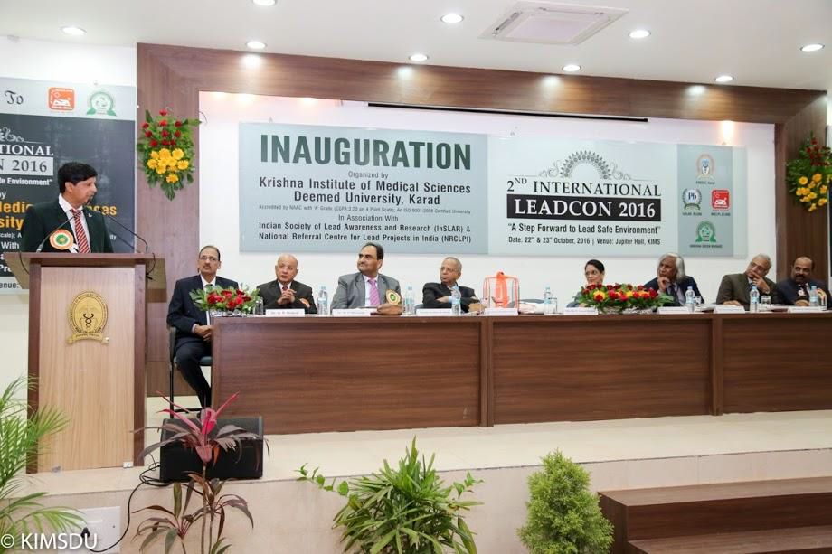

Slide 28
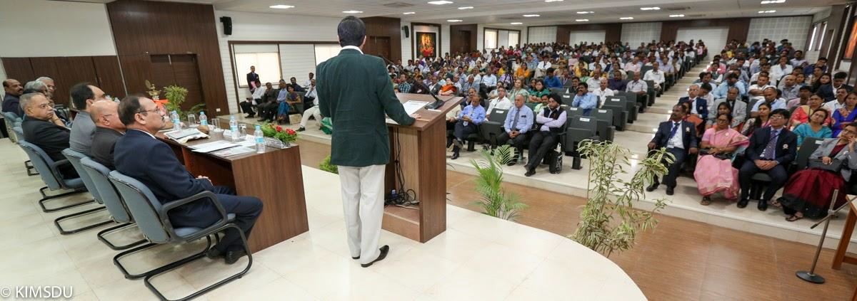
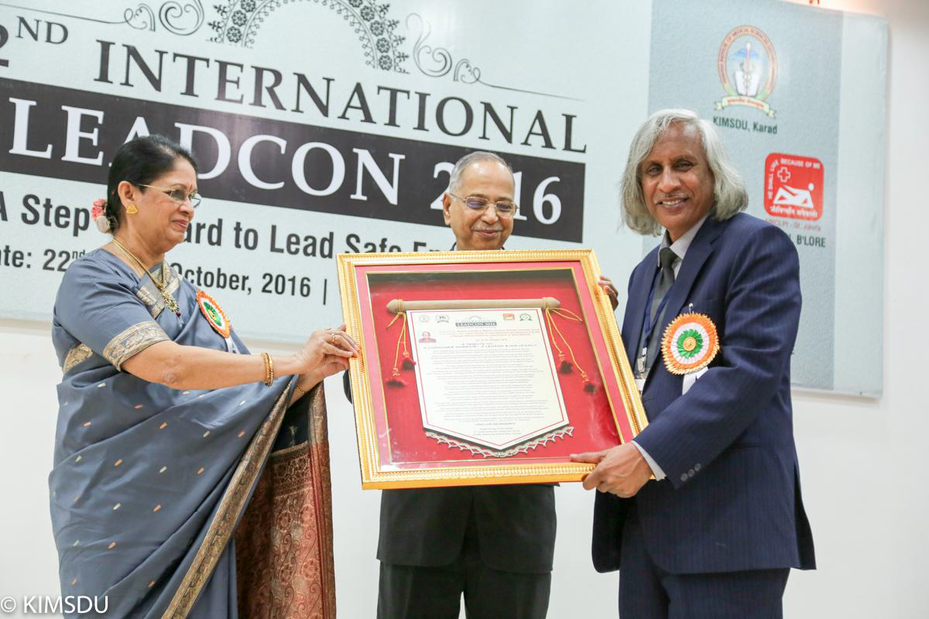
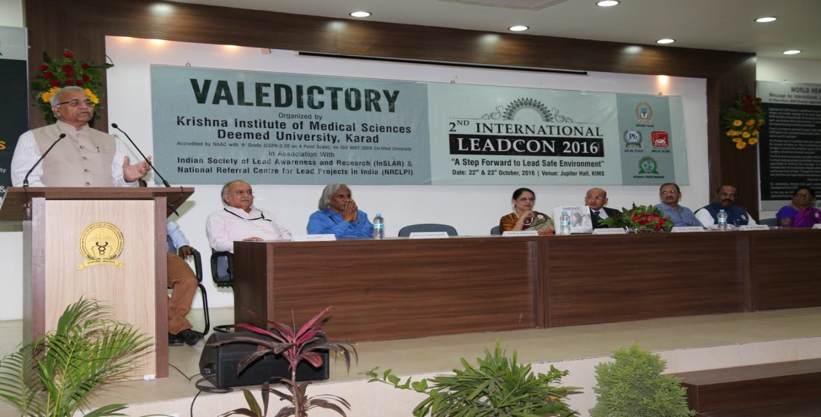

Slide 29
LEADCON Participation
Sr. No. | Participants | Resposibility | Conference Name
1 | Dr. Arun Patil | Panelist member, Resource & Chair Person | 1st International Conference on Lead at AIMS, Jodhpur on Oct. 2015
2 | Dr. Arun Patil Dr. Jyotsna Patil | Panelist member, Resource & Chair Person Presented Paper | 3rd LEADCON 2017, at NIN, Hyderabad on Sept . 2017
3 | Hon’ble Dr. Vedh Prakash Mishra Dr. Arun Patil Dr. Jyotsna Patil Dr. Shilpa Pratinidhi Dr. Shubha Joshi | Guest of Honor Resource & Chair Person Guest of Honor, Resource & Chair Person Resource & Chair Person Resource & Chair Person Resource & Chair Person | 4th LEADCON 2018, at North Bengal Medical College and Hospital, at Siliguri.

Slide 30
LEADCON Participation
Sr. No. | Participants | Resposibility | Conference Name
4 | Dr. Arun Patil Dr. Jyotsna Patil Dr. Shubha Joshi | Panelist member, Resource & Chair Person Resource Person Resource Person | LEADCON 2020- at NIMHANS, Bangalore on 9th & 10th Feb 2020

